Slide 1



Hibernate One-to-Many Bi-Directional

Slide 2




One-to-Many Mapping
An instructor can have many courses
Bi-directional
Course
Course
Instructor
Course
Course
www.luv2code.com

Slide 3




Many-to-One Mapping
Many courses can have one instructor
Inverse / opposite of One-to-Many
Course
Course
Instructor
Course
Course
www.luv2code.com

Slide 4





Real-World Project Requirement
If you delete an instructor, DO NOT delete the courses
If you delete a course, DO NOT delete the instructor
Do not apply cascading deletes!
Course
Course
Instructor
Course
Course
www.luv2code.com

Slide 5
Development Process: One-to-Many
Step-By-Step
Prep Work - Define database tables
Create Course class
Update Instructor class
Create Main App
www.luv2code.com

Slide 6

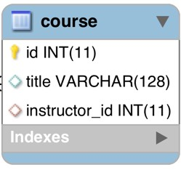


table: course
File: create-db.sql
CREATE TABLE `course` (
`id` int(11) NOT NULL AUTO_INCREMENT,
`title` varchar(128) DEFAULT NULL,
`instructor_id` int(11) DEFAULT NULL,
PRIMARY KEY (`id`),
UNIQUE KEY `TITLE_UNIQUE` (`title`),
...
);
Prevent duplicate course titles
www.luv2code.com

Slide 7


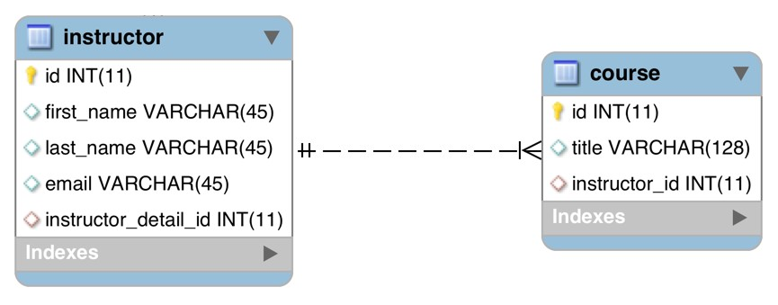
table: course - foreign key
File: create-db.sql
CREATE TABLE `course` (
…
KEY `FK_INSTRUCTOR_idx` (`instructor_id`),
CONSTRAINT `FK_INSTRUCTOR`
FOREIGN KEY (`instructor_id`)
REFERENCES `instructor` (`id`)
…
);
www.luv2code.com

Slide 8

table: instructor - no changes
www.luv2code.com

Slide 9



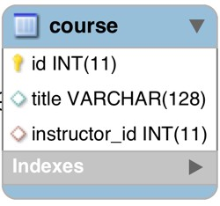
Step 2: Create Course class
@Entity @Table(name="course") public class Course {
@Id @GeneratedValue(strategy=GenerationType.IDENTITY) @Column(name="id")
private int id;
@Column(name="title") private String title;
…
// constructors, getters / setters
}
www.luv2code.com

Slide 10




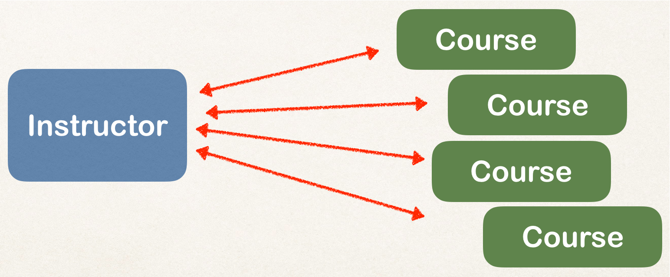
Step 2: Create Course class - @ManyToOne
@Entity @Table(name="course") public class Course {
…
@ManyToOne @JoinColumn(name="instructor_id") private Instructor instructor;
…
// constructors, getters / setters
}
www.luv2code.com

Slide 11

Step 3: Update Instructor - reference courses
@Entity @Table(name="instructor") public class Instructor {
…
private List<Course> courses; public List<Course> getCourses() {
return courses;
}
public void setCourses(List<Course> courses) { this.courses = courses;
}
…
}
www.luv2code.com

Slide 12
Add @OneToMany annotation
@Entity @Table(name="instructor") public class Instructor {
…
@OneToMany(mappedBy="instructor") private List<Course> courses;
public List<Course> getCourses() { return courses;
}
public void setCourses(List<Course> courses) { this.courses = courses;
}
…
}
Refers to “instructor” property in “Course” class
www.luv2code.com

Slide 13


>
public class Instructor {
…
@OneToMany(mappedBy="instructor") private List<Course> courses;
•
mappedBy tells Hibernate
•
Look at the instructor property in the Course class
•
Use information from the Course class @JoinColumn
•
To help find associated courses for instructor
public class Course {
…
@ManyToOne @JoinColumn(name="instructor_id") private Instructor instructor;
www.luv2code.com

Slide 14


Add support for Cascading
Do not apply cascading deletes!
@Entity @Table(name="instructor") public class Instructor {
…
@OneToMany(mappedBy="instructor", cascade={CascadeType.PERSIST, CascadeType.MERGE
CascadeType.DETACH, CascadeType.REFRESH}) private List<Course> courses;
…
}
www.luv2code.com

Slide 15


Add support for Cascading
@Entity @Table(name="course") public class Course {
…
@ManyToOne(cascade={CascadeType.PERSIST, CascadeType.MERGE CascadeType.DETACH, CascadeType.REFRESH})
@JoinColumn(name="instructor_id") private Instructor instructor;
…
// constructors, getters / setters
}
Do not apply
cascading deletes!
www.luv2code.com

Slide 16


Add convenience methods for bi-directional
@Entity @Table(name="instructor") public class Instructor {
…
// add convenience methods for bi-directional relationship
public void add(Course tempCourse) { if (courses == null) {
courses = new ArrayList<>();
}
courses.add(tempCourse); tempCourse.setInstructor(this);
}
…
}
www.luv2code.com

Slide 17

Step 2: Create Main App
public static void main(String[] args) {
…
// get the instructor object
int theId = 1;
Instructor tempInstructor = session.get(Instructor.class, theId);
// print instructor
System.out.println("tempInstructor: " + tempInstructor);
// print the associated courses
System.out.println("courses: " + tempInstructor.getCourses());
…
}
www.luv2code.com

